Slide 1


ROAD TRIP
Spring Break Travel
Project 3
Robyn, Jennifer, Traci, Brittany

Slide 2

JOURNEY
the
Imagine you and a group of your friends are planning a road trip for spring break, or to celebrate passing Data Analytics Boot Camp; however, Covid is still very much on the top of everyone’s mind with new cases and strains popping up all over the country.
To be safe as well as to be able to enjoy your vacation, you want to avoid heavily populated area with high case numbers for Covid.
For this project, we chose 3 states that are popular during the spring break travel season, which usually begins late March and into early April. The 3 states that we chose to look at while planning our girl’s trip is:
Florida
New York
Tennessee
What we will show is the data used from 2020-2023, covid cases in those states and what areas to avoid.

Slide 3



The most three popular states to travel during Spring Break 2020-2023
Florida
New York
Tennessee

Slide 4




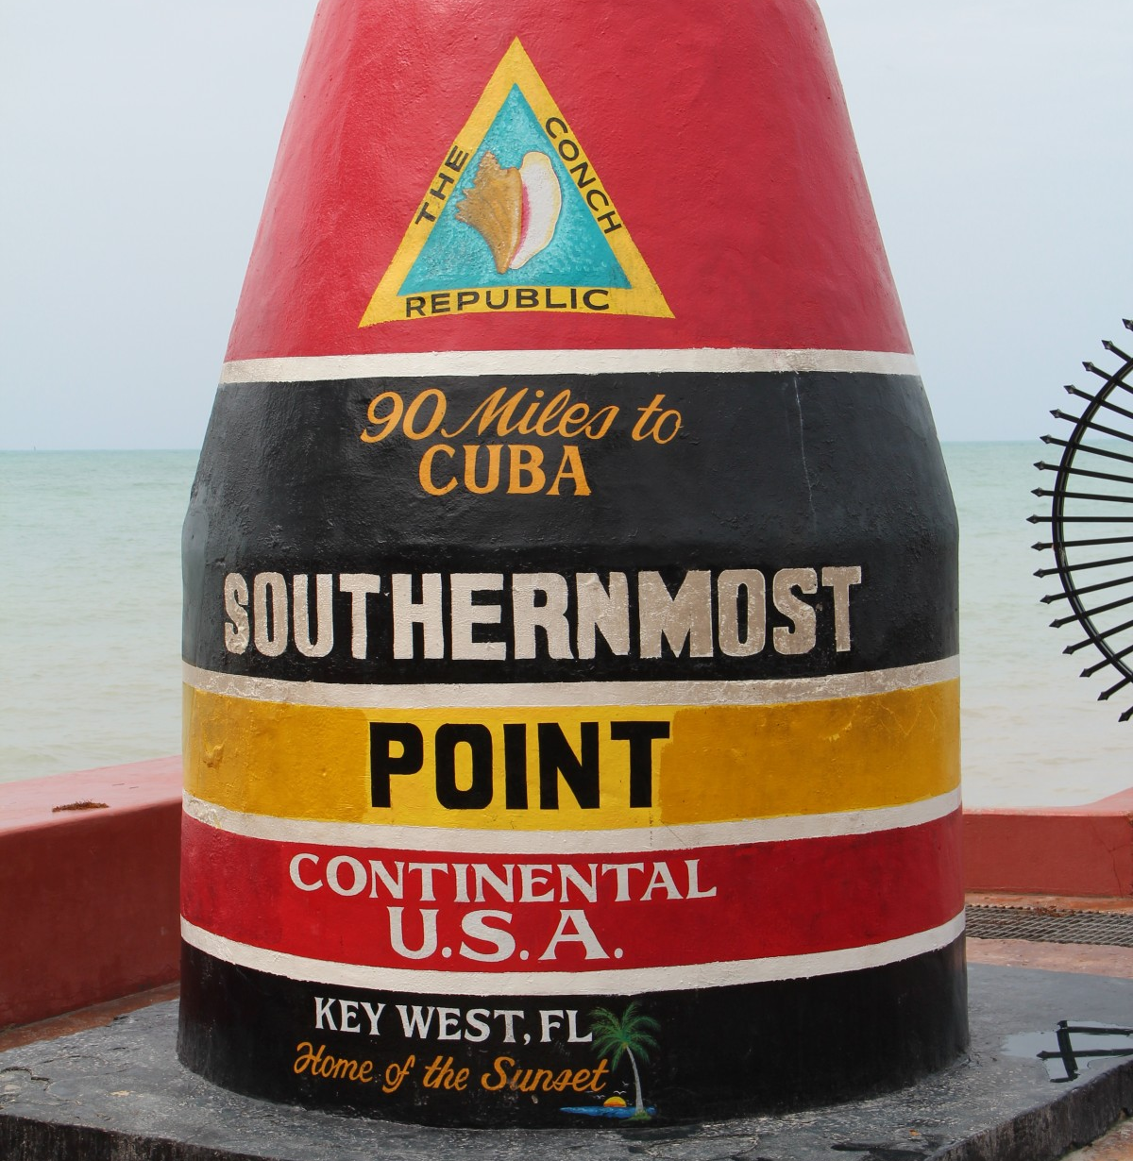



Slide title 7
NYC – Times Square
Disney World
Florida Beaches
Smokey Mountains
Opryland, Nashville TN
Mile Marker Zero- Key West
Catch a Knicks Game
Coney Island NY

Slide 5
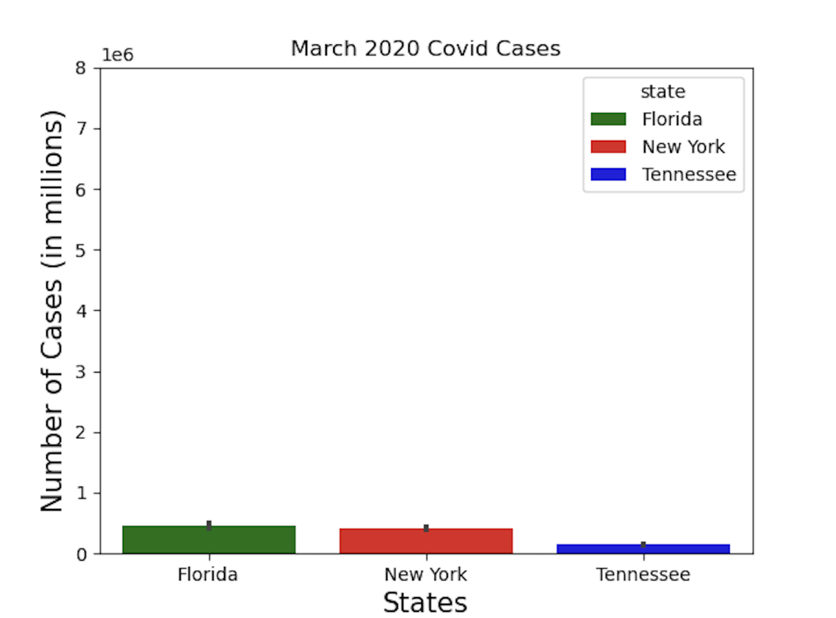
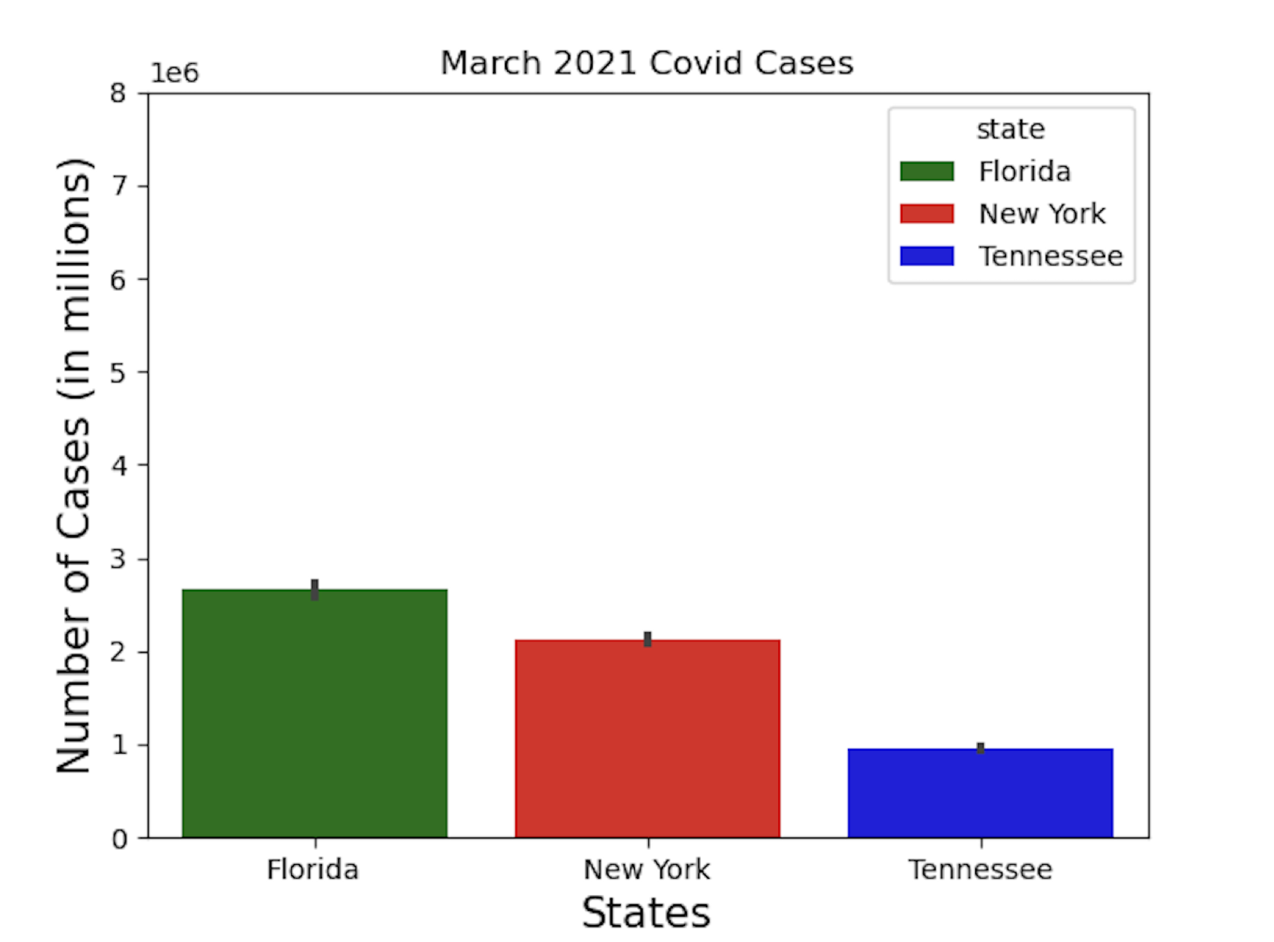
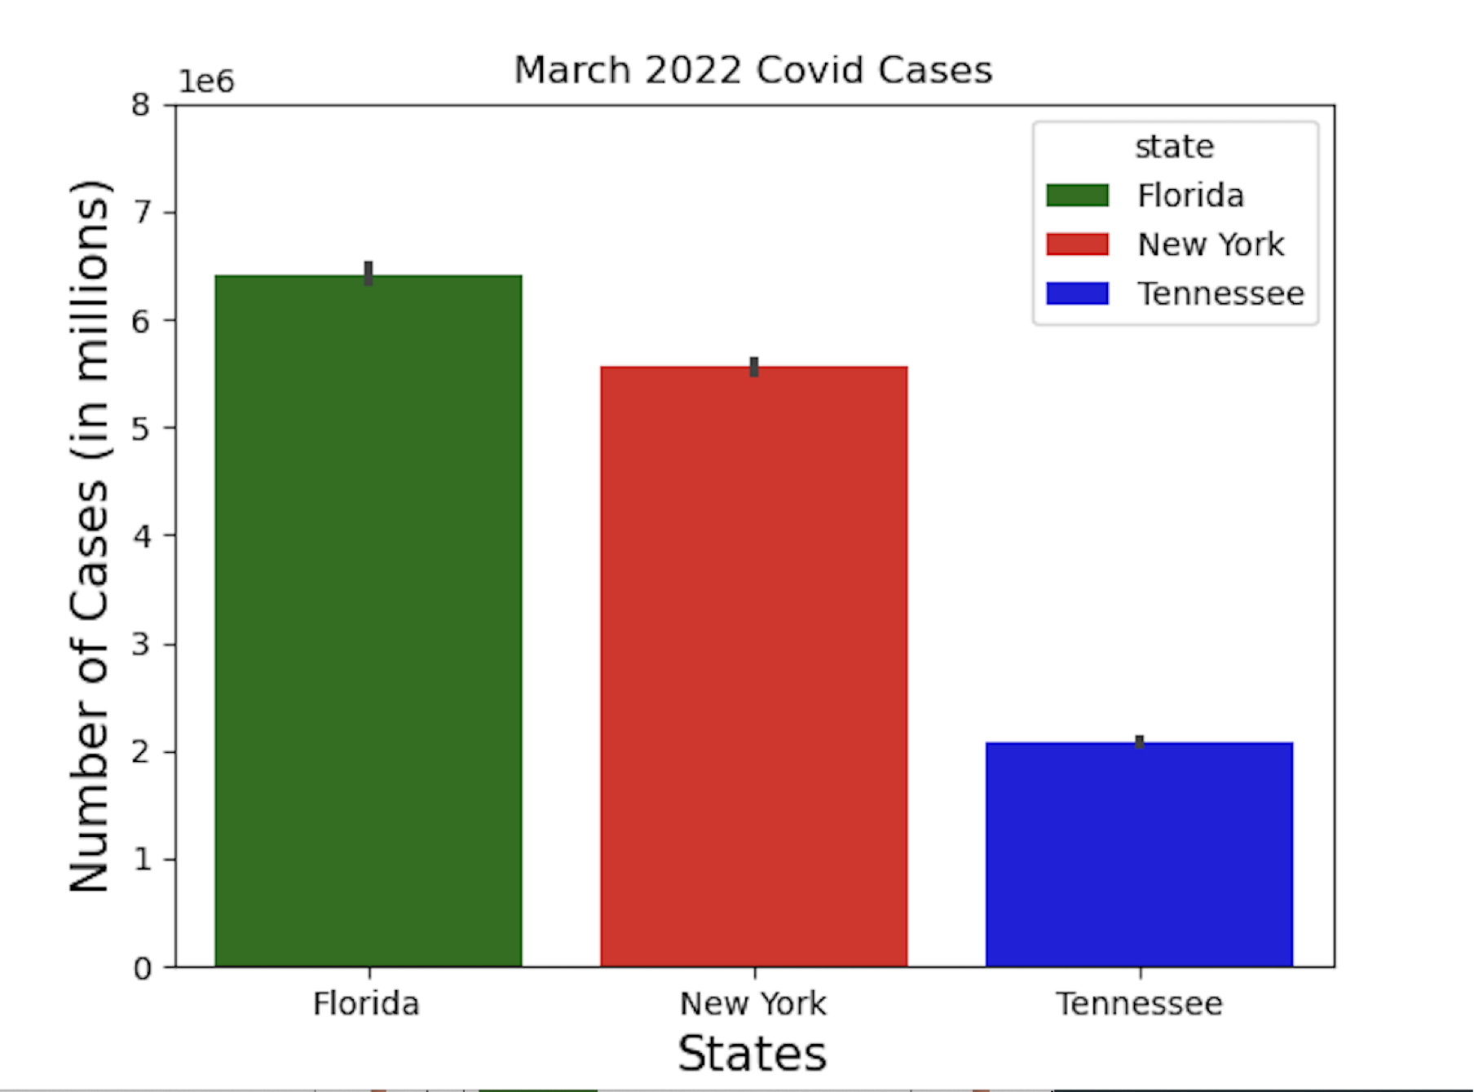
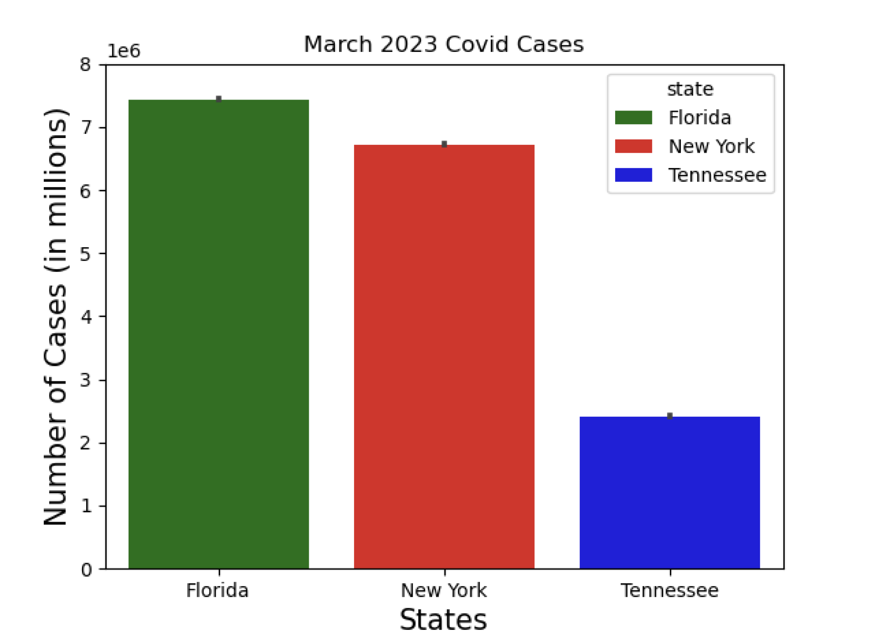
Road
hit the
Before we hit the road, let’s look at the trends in cases for each state based on year.
As we can see from the below graphs, since 2020 the cases in each state have been on the increase. 2023 marked the highest Covid Cases due to the increase in travel over the past 3 years. Florida has seen a significant increase and marks the highest in 2023 alone with 7 million cases.
2020
2021
2022
2023
xv
v

Slide 6
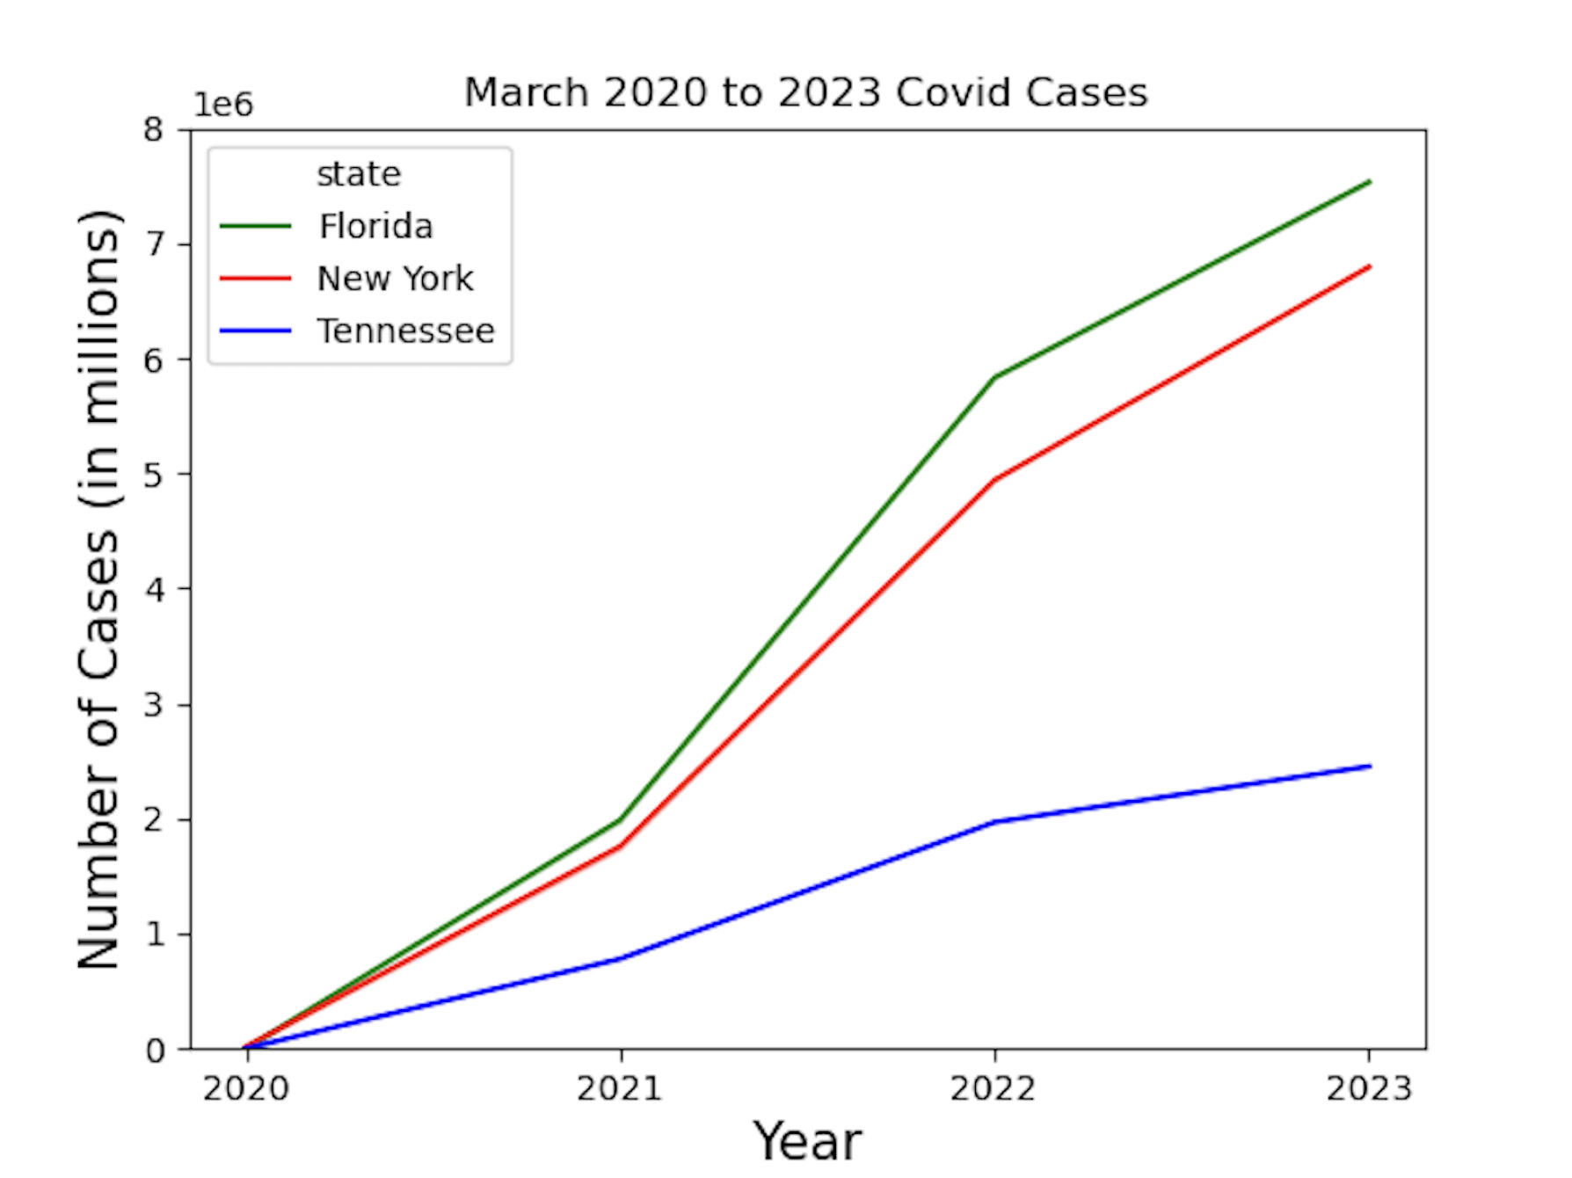
What makes a case a positive case number in our study? Confirmed Cases: Cases where positive tests were confirmed by a laboratory test (viral RNA,RT-PCR) and reported by federal, state or local government authority. Probable Cases: Cases where tests were NOT confirmed but were evaluated by public health officials using criteria such as tests that detect antigens or antibodies. Confirmed Deaths: Deaths where Covid-19 is the primary factor in the person’s death and is confirmed as the primary cause of death. Probable Deaths: Deaths where Covid- 19 may have been present but not confirmed via test and not listed as the primary cause of death.
2020-2023

Slide 7
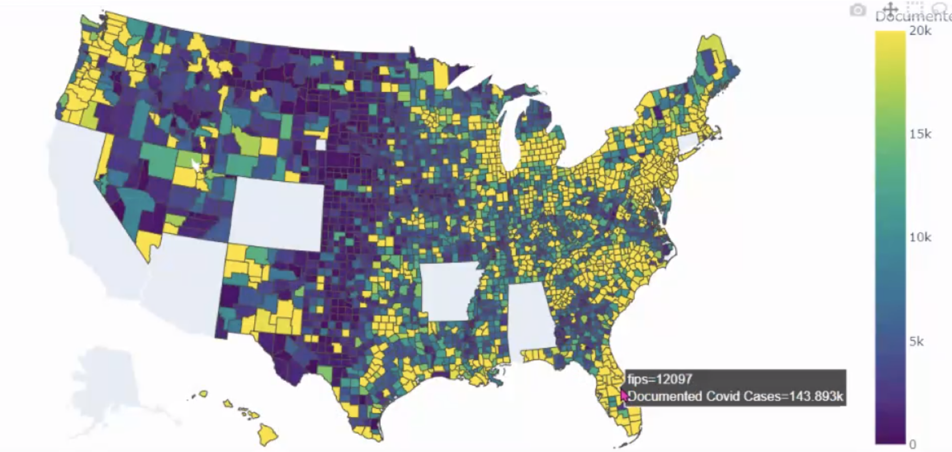
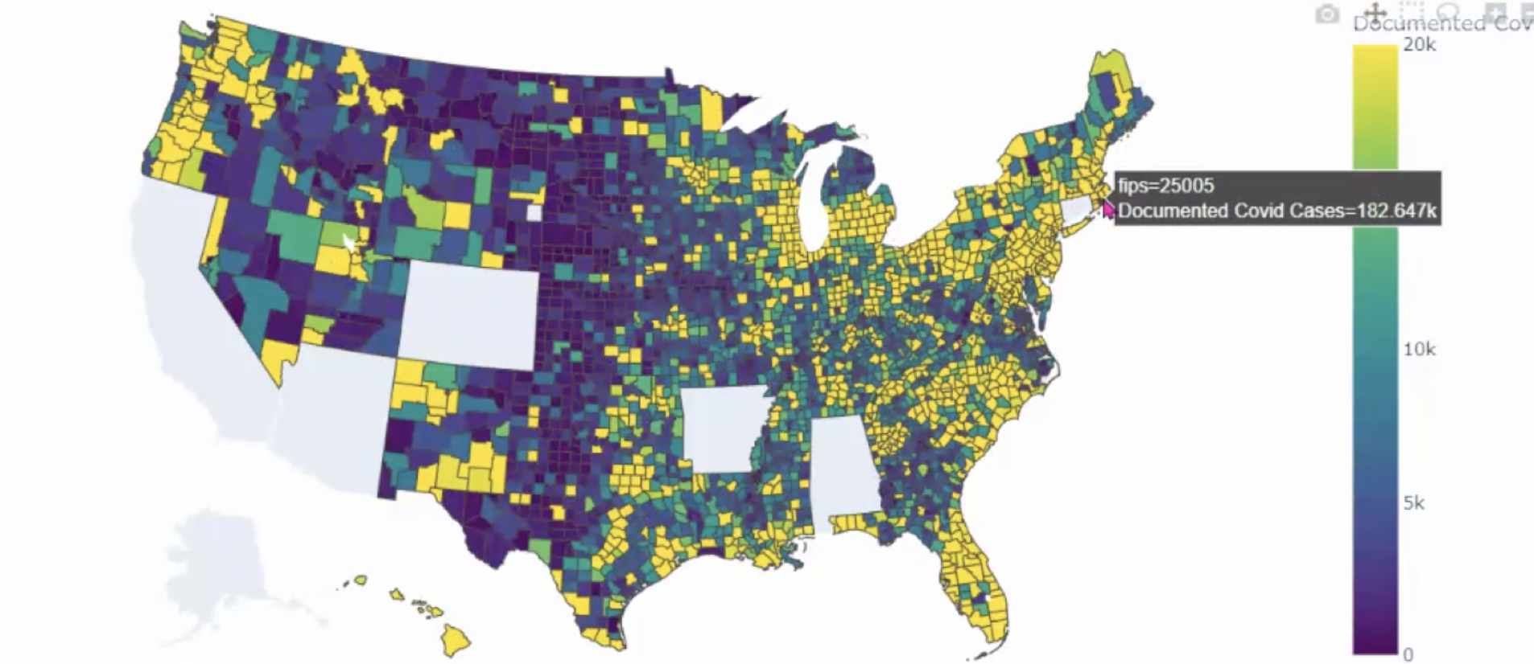
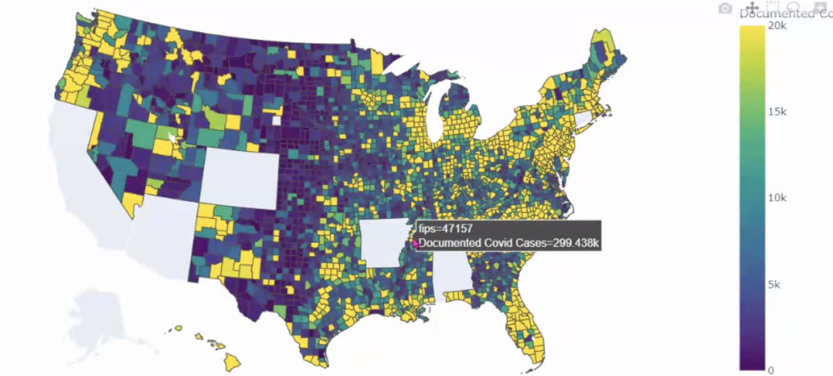
Maps
Interactive View
County View- Cases
If we were to plan our vacation by county instead of by state, our plan would change from Tennessee to Osceola County Florida. This is where Disney is located and the covid cases here are still smaller than Memphis TN or NYC.
12097 Osceola County FL
25005 Bristol County NY
47157 Shelby County TN

Slide 8


ESCAPE
the great
If we were to base our decision solely on which state to visit by the number of Covid cases, then our decision would be Tennessee where the cases are smaller than NY or Florida. However, if we base our decision on active cases strictly by the attraction we want to visit in a particular county, like Shelby County (Memphis TN), or Osceola County (Kissimmee FL) then our decision would be Disney World, as Osceola County has the fewest number of confirmed cases as of March 23, 2023.

Slide 9
Any questions?
References
"The New York Times. (2021). Coronavirus (Covid-19) Data in the United States. Retrieved [09 January 2024], from https://github.com/nytimes/covid-19-data."
Here is a link that shows the US FIPS codes:
https://transition.fcc.gov/oet/info/maps/census/fips/fips.txt#:~:text=FIPS%20codes%20are%20numbers%20which,to%20which%20the%20county%20belongs.
This is where we retrieved the GeoJSON data for our interactive plotly map:
https://raw.githubusercontent.com/plotly/datasets/master/geojson-counties-fips.json

